Slide 1
Prediabetes Is Affecting Your Members: How You Can Help
[Insert organization logo]
Notes:
[WELCOME participants, introduce yourself and your organization. THANK THEM for taking the time to discuss the important topic of how prediabetes is affecting their members and how they can help.]
[SHARE that lifestyle change programs like your program are part of the National Diabetes Prevention Program, led by the Centers for Disease Control and Prevention. The National Diabetes Prevention Program is a public-private partnership of community organizations, private insurers, employers, health care organizations, faith-based organizations, and government agencies.]
[INSERT any personal comments.]

Slide 2

OUTLINE OF PRESENTATION
How prediabetes
is affecting your members
Benefits of the
CDC-recognized lifestyle change program
What you can do
Notes:
Today we’ll briefly cover a few key topics:
How prediabetes is affecting your members
Benefits of the CDC-recognized lifestyle change program
What you can do to bring this program to your members

Slide 3

Prediabetes
A Growing Issue with Serious Consequences for YOUR MEMBERS
Notes:
Prediabetes is a growing workforce issue with serious health and cost consequences.

Slide 4
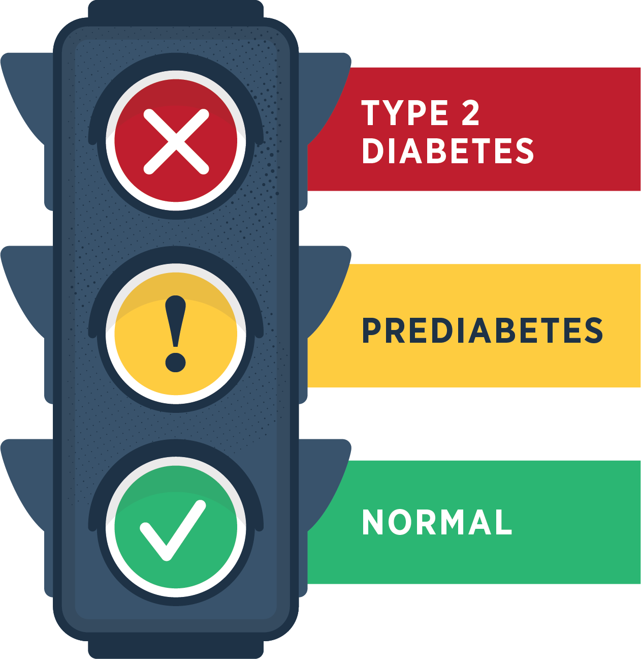
Prediabetes is when your blood sugar level is higher than normal but not high enough yet to be diagnosed as type 2 diabetes.
Notes:
Prediabetes is when your blood sugar level is higher than normal but not high enough yet to be diagnosed as type 2 diabetes

Slide 5


Adults has prediabetes
8
>
Don’t know they have it
Notes:
An estimated 96 million American adults—that’s more than 1 out of 3—and likely a significant number of your employees— have prediabetes. More than 8 out of 10 don’t even know they have it.

Slide 6
Without lifestyle changes, people with prediabetes can develop type 2 diabetes.
Diabetes in adults has doubled in the past two decades.
1 in 3 adults in the U.S. could have diabetes by 2050 if nothing changes.
!
Notes:
Unless they make lifestyle changes, many people with prediabetes will develop type 2 diabetes within a few years.
In fact, diabetes in adults has increased at an alarming rate in the past two decades and it is estimated that 1 in 3 adults in the United States could have diabetes by 2050 if nothing changes. That’s your current AND future workforce.
https://www.ncbi.nlm.nih.gov/pmc/articles/PMC5278808/

Slide 7
People with type 2 diabetes are at higher risk of serious health complications
Kidney failure
blindness
Loss
of toes, feet, or legs
Heart attack
stroke
Notes:
People with type 2 diabetes are at higher risk of serious health complications including kidney failure, blindness, heart attack, stroke, and loss of toes, feet, or legs.

Slide 8

When prediabetes turns into type 2 diabetes…

Slide 9
HEALTH CARE DOLLARS IS SPENT ON PEOPLE DIAGNOSED WITH DIABETES
Diabetes is the COSTLIEST disease in the U.S. at
$327 BILLION in 2017.
Cost of care for people
with diabetes is 2.3 times more than for those
without diabetes.
Annual medical expenditures
in 2017 were $16,750 per person diagnosed with diabetes.
1
4
IN
Estimate your costs and benefits using CDC’s return on investment (ROI) calculator: https://nccd.cdc.gov/Toolkit/DiabetesImpact
Notes:
Diabetes is the costliest of the 155 most common diseases in the country, at $327 billion in 2017, including $237 billion in direct medical costs and $90 billion in indirect costs—that’s an increase of 60% from 2007.
Cost of care for people with diabetes in 2017 was responsible for 1 in every 4 U.S. health care dollars spent, and annual medical expenditures were $16,750 per person with diagnosed diabetes—2.3 times more than for those without diabetes.
To estimate the costs and benefits in your situation, you can use CDC’s return on investment (or ROI) calculator: https://nccd.cdc.gov/Toolkit/DiabetesImpact

Slide 10

The National Diabetes Prevention Program (National DPP)
Lifestyle Change Program
A solution
Notes:
There is a solution to the problem of prediabetes―[insert name of your program].

Slide 11

Program quality and adherence to scientific standards monitored by CDC
A full year of support
Community-based
Cost-effective
CDC-approved curriculum in English and [insert if program is offered in other languages]
Notes:
The program is part of the National Diabetes Prevention Program, led by the Centers for Disease Control and Prevention, and offers a full year of support.
It can prevent or delay type 2 diabetes in high-risk individuals, such as those with prediabetes.
Accessibility is key for participation, so the program is currently offered in our community, at [insert locations].
The program uses a CDC-approved curriculum and is monitored by CDC to ensure quality and adherence to scientific standards.
The cost per person is low, depending on factors such as promotion, recruitment, staff, and logistics costs. The cost of preventing diabetes is typically much lower than the cost of dealing with the disease’s consequences.
It’s cost-effective and can be cost-saving through reductions in health care spending.

Slide 12
The National DPP Lifestyle Change Program
WORKS!
58%
Can prevent or delay type 2 diabetes by
Notes:
This program works. And it will work for your members.
Research examining the effects of a structured lifestyle change program like ours showed that losing 5 to 7 percent of body weight by eating healthy and increasing physical activity reduced the risk of developing type 2 diabetes by 58 percent in people at high risk for the disease. In individuals over 60 years old, it reduced risk by 71 percent.
Evidence is based on a large, rigorously designed randomized control trial with a diverse population.
The impact of the lifestyle intervention was similar, regardless of race, ethnicity, or gender.
Even after 10 years, those who participated in the earlier lifestyle change program had a 34 percent lower rate of type 2 diabetes.

Slide 13
Testimonial can go here and be a few lines long.
—First Last name
Notes:
[This should be a positive comment from another insurance company or from a member. For example: “The program helped us to identify members with prediabetes earlier, and based on year over year comparisons, resulted in fewer diagnoses of type 2 diabetes as well as saved costs.” – Jane Q. Business, Insurance Executive OR “I’m really thankful this program was covered by my insurance. Not only do I feel better, I’ve lost weight and have more energy than I’ve had in years.” – Sue M. Employee]
Testimonials available here: https://nationaldppcsc.cdc.gov/s/article/Testimonials-from-Participants

Slide 14
Testimonial can go here and be a few lines long.
—First Last name

Slide 15

What can you do?
Consider offering this program at the next review of benefits and disease management programs
It can help you lower health care costs—keeping premiums down for your members and improving their quality of life.
Work with the National Diabetes Prevention Program provider to promote the program to your members by including information in emails, in your newsletter, and on your website.
Notes:
How can you help your members address prediabetes? Employers are eager to hear about new strategies to address the rising human and financial costs of prediabetes and diabetes. Consider offering this program to them at your next health benefits review or open enrollment period.
It’s a win-win. The program can help you lower health care costs, and help your members control rising premiums. You’ll also be protecting the health of your members.
There are third-party administrators available to help determine potential return on investment, as well as implement the program, process claims, recruit participants, and collect data. Or you can use CDC’s cost calculator available at https://nccd.cdc.gov/Toolkit/DiabetesImpact to estimate ROI.
The National Diabetes Prevention Program also has materials available to help engage employers and promote the program among your members.

Slide 16
You’ll be in good company
Leading insurers nationwide are offering the program as one way to address rising costs.
Be a leader and offer the National DPP lifestyle change program as a covered health benefit!
For more examples of insurers covering the program, see https://coveragetoolkit.org/participating-payers/
Notes:
Insurers are offering the program to their members across the country. Participating insurers include Medicare, Cigna and Humana. Many more are looking for new solutions to address the mounting costs.
For more examples, take a look at coveragetoolkit.org/participating-payers/
Type 2 diabetes is an issue everyone is concerned about―so be a leader with your members and among your peers. Drive change against this mounting problem and offer [insert name of your program] to your members.

Slide 17
Reimbursement
Many employers use a pay-for-performance model of reimbursement for the lifestyle change program.
Employers only pay if employee meets milestones. Reimbursement is
connected to results.
Notes:
Many employers use a pay-for-performance model of reimbursement for the lifestyle change program.
Employers do not pay for the lifestyle change program as part of a benefits package; they only pay if an employee enrolls in the program and reaches certain milestones.
If the employee is not successful in meeting milestones, the employer does not have to pay for the employee’s participation.
Simply put: Reimbursement is connected to results.

Slide 18
For more information
CONTACT [Insert name/phone/email]
WEBSITE [Insert local website address]
CDC www.cdc.gov/diabetes/prevention
Notes:
For more information on our local program, contact [INSERT contact information].
For information on the National Diabetes Prevention Program and the CDC-recognized lifestyle change program, visit www.cdc.gov/diabetes/prevention.
Additional resources, infographics: https://www.cdc.gov/diabetes/library/socialmedia/infographics.html

Slide 19

Questions?
Notes:
Thank you for your time today!
At this time, I’d like to open the floor for any questions you may have.

Slide 20

American Diabetes Association. Economic costs of diabetes in the U.S. in 2017. Diabetes Care. 2018;41:917–928.
Bardenheier BH, Lin J, Zhuo X, et al. Disability-free life-years lost among adults aged ≥50 years, with and without diabetes. Diabetes Care. 2016;39:1222–1229.
Boyle JP, Thompson JT, Gregg EW, et al. Projections of the year 2050 burden of diabetes in the US adult population: dynamic modeling of incidence, mortality, and prediabetes prevalence. Popul Health Metr 2010;8:1–29.
Centers for Disease Control and Prevention. Diabetes Prevention Recognition Program WORKING WITH EMPLOYERS AND INSURERS GUIDE for CDC-Recognized Organizations. 2017.
Centers for Disease Control and Prevention. National Diabetes Statistics Report website. https://www.cdc.gov/diabetes/data/statistics-report/Index.html. Accessed July 15, 2022.
Diabetes Prevention Programs: Effectiveness and Value Final Evidence Report and Meeting Summary July 25, 2016, Institute for Clinical and Economic Review. Retrieved from https://icer-review.org/wp-content/uploads/2016/07/CTAF_DPP_Final_Evidence_Report_072516.pdf
Diabetes Prevention Program Research Group. 10-year follow-up of diabetes incidence and weight loss in the Diabetes Prevention Program Outcomes Study. Lancet. 2009;374:1677–86.
Dieleman JL, Baral R, Birger Ml, et al. U.S. spending on personal health care and public health, 1996–2013. JAMA. 2016;316:2627–2646.
Knowler, WC, Barrett-Connor, E, et al. Reduction in the incidence of type 2 diabetes with lifestyle intervention or metformin. N Engl J Med. 2002;346(6):393–403.
Rowley WR, Bezold C, Arikan Y, et al. Diabetes 2030: Insights from Yesterday, Today, and Future Trends. Popul Health Manag. 2017;20(1):6-12.
SOURCES CITED

