Slide 1
Prediabetes Is Affecting Your Workforce: How You Can Help
[Insert organization logo]
Notes:
[WELCOME participants, introduce yourself and your organization. THANK THEM for taking the time to discuss the important topic of how prediabetes is affecting their workforce and how they can help.]
[SHARE that lifestyle change programs like your program are part of the National Diabetes Prevention Program, led by the Centers for Disease Control and Prevention. The National Diabetes Prevention Program is a public-private partnership of community organizations, private insurers, employers, health care organizations, faith-based organizations, and government agencies.]
[INSERT any personal comments.]

Slide 2

OUTLINE OF PRESENTATION
How prediabetes
is affecting your workforce
Benefits of the
CDC-recognized lifestyle change program
What you can do
Notes:
Today we’ll briefly cover a few key topics:
How prediabetes is affecting your workforce
Benefits of the CDC-recognized lifestyle change program
What you can do to bring this program to your employees

Slide 3

Prediabetes
A Growing Issue with Serious Consequences for YOUR Workforce
Notes:
Prediabetes is a growing workforce issue with serious health and cost consequences.

Slide 4
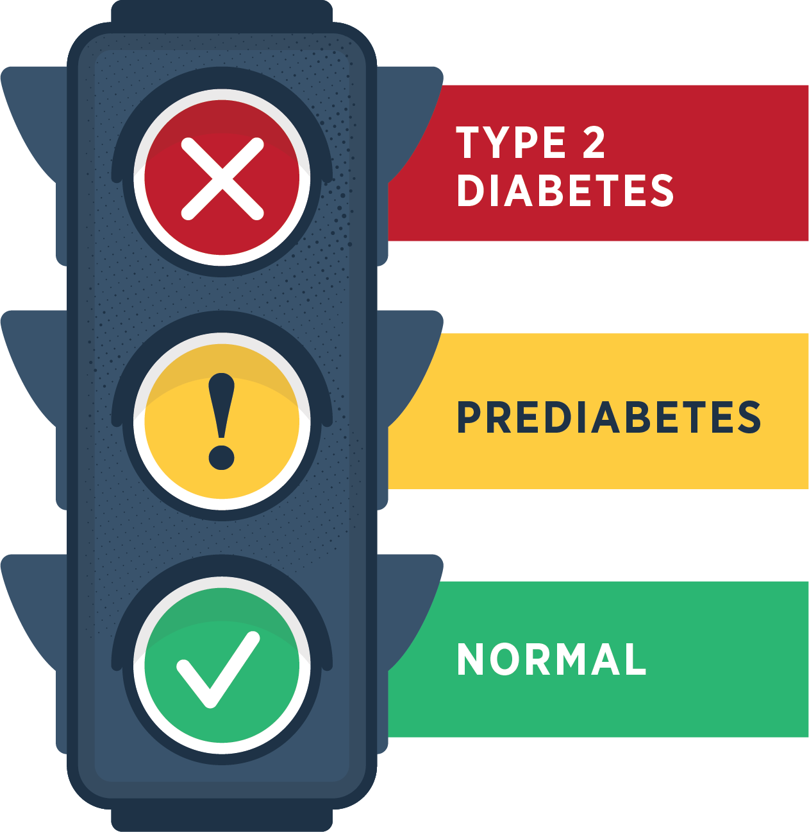
Prediabetes is when your blood sugar level is higher than normal but not high enough yet to be diagnosed as type 2 diabetes.
Notes:
Prediabetes is when your blood sugar level is higher than normal but not high enough yet to be diagnosed as type 2 diabetes

Slide 5


Adults has prediabetes
8
>
Don’t know they have it
Notes:
An estimated 96 million American adults—that’s more than 1 out of 3—and likely a significant number of your employees— have prediabetes. More than 8 out of 10 don’t even know they have it.

Slide 6
Without lifestyle changes, people with prediabetes can develop type 2 diabetes.
Diabetes in adults has doubled in the past two decades.
1 in 3 adults in the U.S. could have diabetes by 2050 if nothing changes.
!
Notes:
Unless they make lifestyle changes, many people with prediabetes will develop type 2 diabetes within a few years.
In fact, diabetes in adults has increased at an alarming rate in the past two decades and it is estimated that 1 in 3 adults in the United States could have diabetes by 2050 if nothing changes. That’s your current AND future workforce.
https://www.ncbi.nlm.nih.gov/pmc/articles/PMC5278808/

Slide 7
People with type 2 diabetes are at higher risk of serious health complications
Kidney failure
blindness
Loss
of toes, feet, or legs
Heart attack
stroke
Notes:
People with type 2 diabetes are at higher risk of serious health complications including kidney failure; blindness; heart attack; stroke; and loss of toes, feet, or legs.

Slide 8

When prediabetes turns into type 2 diabetes…

Slide 9
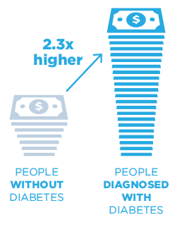
AVERAGE MEDICAL EXPENDITURES
Diabetes is the COSTLIEST disease in the U.S. at
$327 BILLION in 2017 and contributes to reduced productivity and absenteeism.
Cost of care for people with diabetes is 2.3 times more than for those without diabetes.
Annual medical expenditures
in 2017 were $16,750 per person diagnosed with diabetes.
Estimate costs and benefits for your workplace using CDC's return on investment (ROI) calculator: https://nccd.cdc.gov/Toolkit/DiabetesImpact
Notes:
Diabetes not only affects your employees’ well-being, but also your company’s bottom line. It’s the costliest of the 155 most common diseases in the country—at $327 billion in 2017, including $237 billion in direct medical costs and $90 billion in indirect costs such as reduced productivity and absenteeism. That’s an increase of 60% from 2007.
Cost of care for people with diabetes in 2017 was responsible for 1 in every 4 U.S. health care dollars spent, and annual medical expenditures were $16,750 per person with diagnosed diabetes—2.3 times as much as for those without diabetes.
Diabetes doubles the risk of physical disability; adults with diabetes who are 50 years or older lose independence 6–7 years before their peers without diabetes.
To estimate the costs and benefits for your workplace, you can use CDC's return on investment (or ROI) calculator: https://nccd.cdc.gov/Toolkit/DiabetesImpact

Slide 10

The National Diabetes Prevention Program (National DPP)
Lifestyle Change Program
A solution
Notes:
There is a solution to the problem of prediabetes―[insert name of your program].

Slide 11

Program quality and adherence to scientific standards monitored by CDC recognition program
A full year of support
Community-based
Cost-effective
CDC-approved curriculum in English and [insert if program is offered in other languages]
Notes:
The program is part of the National Diabetes Prevention Program, led by the Centers for Disease Control and Prevention, and offers a full year of support.
Can prevent or delay type 2 diabetes in high-risk individuals, such as those with prediabetes.
Accessibility is key for participation, so the program is currently offered in our community at [insert locations].
It’s cost-effective and can be cost-saving through reductions in health care spending.
The program uses a CDC-approved curriculum and is monitored by CDC to ensure quality and adherence to scientific standards.
The cost per person is low, depending on factors such as promotion, recruitment, staff, and logistics costs. The cost of preventing diabetes is typically much lower than the cost of dealing with the disease’s consequences.

Slide 12
The National DPP Lifestyle Change Program
WORKS!
58%
Can prevent or delay type 2 diabetes by
Notes:
This program works and we can help make it work for your employees.
Research examining the effects of a structured lifestyle change program like ours showed that losing 5 to 7 percent of body weight by eating healthy and increasing physical activity reduced the risk of developing type 2 diabetes by 58 percent in people at high risk for the disease. In individuals over 60 years old, it reduced risk by 71 percent.
The impact of the lifestyle intervention was similar regardless of race, ethnicity, or gender.
Even after 10 years, those who participated in the lifestyle change program had a 34 percent lower rate of type 2 diabetes.

Slide 13
Testimonial can go here and be a few lines long.
—First Last name
Notes:
[This could be a quote from a business on how the program helped them and their employees, or a quote from an employee on how grateful they are that their company cares about their health. For example: “We were frankly surprised and delighted by the return on investment of adding this as a covered benefit. After years of increasing healthcare costs, we’ve seen a leveling off. And we’ve seen a reduction in absenteeism due to illness” – President, Business, Inc. OR “This program was a real blessing for me. I feel better than I’ve felt in years, and I feel more productive at work and better able to enjoy my free time.” – Joe Q. Employee]
Testimonials available here: https://nationaldppcsc.cdc.gov/s/article/Testimonials-from-Participants

Slide 14
Testimonial can go here and be a few lines long.
—First Last name

Slide 15


What can you do?
Talk to your insurer about including CDC-approved lifestyle change programs like
ours as a covered health benefit
and offer it to
your employees.
Estimate Return on Investment
with CDC’s cost calculator at https://nccd.cdc.gov/Toolkit/DiabetesImpact.
Consider offering the program at your worksite
with help from one of our trained lifestyle coaches.
Work with the National Diabetes Prevention Program to promote the program by including information in emails and your newsletter, on your website, and by placing fact sheets and posters in common areas.
Notes:
So how can you help your employees address prediabetes and prevent or delay type 2 diabetes?
If the program isn’t yet covered by your health insurance provider, talk to them. They place great value in your preferences. Request the lifestyle change program be covered as a health benefit for your next open enrollment period.
If your insurer is unfamiliar with program, there are third-party administrators available to help determine potential Return On Investment (ROI) specific to your organization, as well as implement the program, process claims, recruit participants, and collect data. Or you can use CDC’s cost calculator available at https://nccd.cdc.gov/Toolkit/DiabetesImpact to estimate ROI.
We also have materials available to help you talk with decision makers at your company, as well as with your insurer.
Consider offering the program at your worksite or work with us to promote the program being offered at our location.
The National Diabetes Prevention Program provides resources that you can use to promote the program to employees, such as a poster for the workplace; an email, newsletter, or website template; and fact sheet describing the program and its benefits.

Slide 16
You’ll be in good company
Leading employers nationwide are offering the program as one way to address rising costs.
CDC’s Diabetes Prevention Impact Toolkit can help your organization determine your ROI.
For more examples of employers covering the program, see https://coveragetoolkit.org/participating-payers/
Notes:
Lifestyle change programs like ours are making an impact across the country today. A number of the nation’s most respected companies―including Fortune 100 companies, such as Costco―have successfully adopted this program.
For more examples, take a look at coveragetoolkit.org/participating-payers/
We know companies are looking to reduce costs while improving employee health. This program helps you do both while ensuring the health of your employees. I can provide you with a tool―the CDC’s Diabetes Prevention Impact Toolkit―that helps determine your organization’s specific ROI from a lifestyle change program.

Slide 17
For more information
CONTACT: [Insert name/phone/email]
WEBSITE: [Insert local website address]
CDC: www.cdc.gov/diabetes/prevention
Notes:
For more information on our local program, contact [INSERT contact information].
For information on the National Diabetes Prevention Program and the CDC-approved lifestyle change program, visit www.cdc.gov/diabetes/prevention.
Additional resources, infographics: https://www.cdc.gov/diabetes/library/socialmedia/infographics.html

Slide 18

Questions?
Notes:
Thank you for your time today!
At this time, I’d like to open the floor for any questions you may have.

Slide 19

American Diabetes Association. Economic costs of diabetes in the U.S. in 2017. Diabetes Care. 2018;41:917–928.
Bardenheier BH, Lin J, Zhuo X, et al. Disability-free life-years lost among adults aged ≥50 years, with and without diabetes. Diabetes Care. 2016;39:1222–1229.
Boyle JP, Thompson JT, Gregg EW, et al. Projections of the year 2050 burden of diabetes in the US adult population: dynamic modeling of incidence, mortality, and prediabetes prevalence. Popul Health Metr 2010;8:1–29.
Centers for Disease Control and Prevention. Diabetes Prevention Recognition Program WORKING WITH EMPLOYERS AND INSURERS GUIDE for CDC-Recognized Organizations. 2017.
Centers for Disease Control and Prevention. National Diabetes Statistics Report website. https://www.cdc.gov/diabetes/data/statistics-report/Index.html. Accessed July 15, 2022.
Diabetes Prevention Programs: Effectiveness and Value Final Evidence Report and Meeting Summary July 25, 2016, Institute for Clinical and Economic Review. Retrieved from https://icer-review.org/wp-content/uploads/2016/07/CTAF_DPP_Final_Evidence_Report_072516.pdf
Diabetes Prevention Program Research Group. 10-year follow-up of diabetes incidence and weight loss in the Diabetes Prevention Program Outcomes Study. Lancet. 2009;374:1677–86.
Dieleman JL, Baral R, Birger Ml, et al. U.S. spending on personal health care and public health, 1996–2013. JAMA. 2016;316:2627–2646.
Knowler, WC, Barrett-Connor, E, et al. Reduction in the incidence of type 2 diabetes with lifestyle intervention or metformin. N Engl J Med. 2002;346(6):393–403.
Rowley WR, Bezold C, Arikan Y, et al. Diabetes 2030: Insights from Yesterday, Today, and Future Trends. Popul Health Manag. 2017;20(1):6-12.
SOURCES CITED

