Slide 1
Health Equity and the National Diabetes Prevention Program
Modifiable Slide Deck – April 2023

Slide 2
Health Equity Modifiable Slide Deck Table of Contents
DELETE SLIDE BEFORE PRESENTING
About the Health Equity Modifiable Slide Deck
Health Equity Background and Overview
Health Equity and Diabetes
Health Equity and the National Diabetes Prevention Program
Local Landscape and Need
Examples and Partner Roles
Health Equity and Medicaid
Health Equity and UHAs
Discussion Questions and Engagement Tips
Additional Resources

Slide 3
About the Health Equity Modifiable Slide Deck
DELETE SLIDE BEFORE PRESENTING
Purpose:
This deck was created to support conversations between State Health Departments and partners who are being engaged to expand the National Diabetes Prevention Program (National DPP). Specifically, content supports the potential for the National DPP to help achieve health equity goals, reduce health disparities, and overcome health and economic social needs.
Intended audience examples:
Medicaid managed care organizations (MCOs), Medicare Advantage (MA) plans, commercial health care payers, employers, etc.
State agencies (e.g., Departments of Medicaid, Aging, Disabilities, Housing, Public Health)
Organizational leadership
When to use:
As part of strategic conversations to obtain buy-in, create alliances, and initiate collaborations to improve health equity.

Slide 4
Instructions for Using the Health Equity Modifiable Slide Deck
DELETE SLIDE BEFORE PRESENTING
Read slide 2 to understand the purpose of the deck and how to use the deck.
Review the content slides and select the ones which may be useful for your presentation.
Delete slides that are not relevant, including slides 2-4, and the green instructions found on the right-hand side of modifiable slides boxes prior to presenting/sharing.
Modify and personalize slides using information specific to your area, information on additional initiatives, your organizational logo or template, etc.
Sample talking points are provided in the notes section of each slide which may be modified to meet your unique needs. Presentation instructions are shown in bolded text.

Slide 5
Agenda
EDIT SLIDE BEFORE PRESENTING
DELETE PRIOR TO SHARING
This slide is intended to be used as an agenda for meetings with partners and can be adjusted to fit your unique needs. Slides 2-4 are for information purposes for deck users and should be deleted prior to presenting to partners.
Introductions
Health Equity Background and Overview
Health Equity and Diabetes
Health Equity and the National Diabetes Prevention Program
Local Landscape and Need
Examples and Partner Roles
Health Equity and Medicaid
Health Equity and UHAs
Q&A and Next Steps

Slide 6
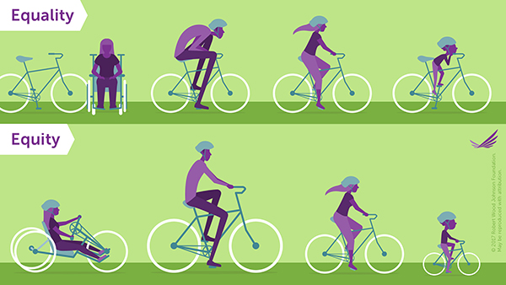
Defining Health Equity
Term | Definition
Health equity | the state in which everyone has a fair and just opportunity to attain their highest level of health
Health disparities | a particular type of health difference that is closely linked with social, economic, and/or environmental disadvantage
Social determinants of health (SDOH) | the conditions in the environments where people are born, live, learn, work, play, worship, and age that affect a wide range of health, functioning, and quality of life outcomes and risks
Health-related social needs (HRSN) | immediate individual or family needs impacted by social and economic conditions (i.e., housing insecurity, food insecurity, or lack of reliable transportation)
Understanding what is meant by health equity and related terms is critical to its promotion. Aligning partner goals and cross-sector communication are key to achieving collective health impacts.
© 2017 Robert Wood Johnson Foundation
Source information: National DPP Coverage Toolkit Defining Health Equity page
Notes:
Before we begin our conversation today, it is important to level-set on definitions for key terms surrounding the topic of health equity. There are several acceptable definitions for these terms, but it is important we have consensus to support a more productive conversation. Finding consensus around definitions can bridge differences and promote productive dialogue around important issues.
We can begin with health equity.
The CDC defines Health Equity as the state in which everyone has a fair and just opportunity to attain their highest level of health. As you see here in the picture to the left, that may not mean providing everyone with identical resources. Instead, health equity implies that everyone has a fair opportunity to achieve their full health potential and involves removing “avoidable, unfair, or remediable differences [in services] among groups of people”.
Health Disparities are a particular type of preventable health difference that is closely linked with social, economic, and/or environmental disadvantage. These affect groups of people who have systematically experienced greater obstacles to health based on their racial or ethnic group, religion, socioeconomic status, sex, etc.
Social Determinants of Health, or SDOH, are the conditions in the environments where people are born, live, learn, work, play, worship, and age that affect quality of life outcomes and health-related risks. Disparities in these conditions are what contribute to health inequities.
While everyone experiences social determinants of health, some populations and individuals may have health-related social needs, or HRSN, stemming from these factors. While SDOH are broader social conditions, HRSN are more immediate individual or family needs impacted by those conditions such as housing insecurity, food insecurity, or lack of reliable transportation. [TRANSITION TO NEXT SLIDE]

Slide 7
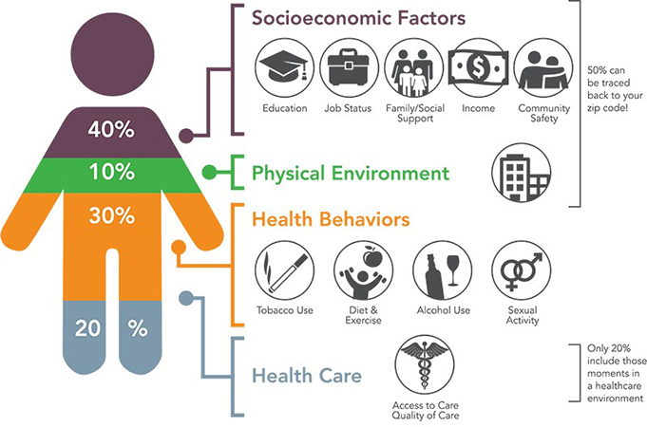
HRSN and Individual Health
Estimates indicate that only 20% of an individual’s health is based on their access to quality health care; whereas a person’s social, environmental, and behavioral conditions can determine up to 80% of their overall health¹.
Due in part to having higher unmet HRSN, studies have shown that diabetes impacts racial and ethnic minority and low-income adult populations disproportionately as evidenced by a higher risk of type 2 diabetes and higher rates of diabetes complications and mortality^{2, 3, 4}.
Source: Institute for Clinical Systems Improvement, Going Beyond Clinical Walls; Solving Complex Problems (October 2014)
Source information: National DPP Coverage Toolkit Connecting SDOH and HRSN to Prediabetes and Type 2 Diabetes page
Notes:
Understanding SDOH and addressing HRSN is critical to reducing health disparities and promoting health equity in our community. While access to high-quality health care is important, estimates indicate that only 20% of an individual’s health is based on their access to and quality of health care; whereas a person’s social, environmental, and behavioral conditions can determine up to 80% of their overall health, some of those factors are shown here in the figure to the left.
Research shows consistent and significant disparities in diabetes outcomes across populations. Many studies have shown that diabetes impacts racial and ethnic minority and low-income adult populations disproportionately as evidenced by a higher risk of type 2 diabetes and higher rates of diabetes complications and mortality. This high risk is largely related to social determinants of health and health-related social needs. We will talk more about this on the next slide. [TRANSITION TO NEXT SLIDE]

Slide 8
Connecting SDOH and Diabetes in [STATE]
DELETE PRIOR TO SHARING
This slide is intended to be populated using HRSN data from your area in order to contextualize the issue for your partners. If you do not have access to this data, percentages can be removed, and slide can be presented only with existing information on SDOH in relation to diabetes. C
Many studies over the last several decades have shown disparities in diabetes outcomes across populations with different SDOH.
Lower income and unemployment
___%
Housing insecurity
___%
Increased rates of and/or complications associated with type 2 diabetes
Food insecurity
___%
Un-/under-insured or lower quality of care
___%
Less than a high school education
___%
Low levels of social cohesion
___%
Which of these populations do we consider high priority for our area?
Source information: National DPP Coverage Toolkit Connecting SDOH and HRSN to Prediabetes and Type 2 Diabetes page
Notes:
[Note: This slide contains animations – use your mouse or spacebar to click through each option and bring it onto the slide]:
Some populations that have a higher risk of type 2 diabetes include:
Lower income individuals and those experiencing job insecurity, unemployment, or long work hours. [Note: data may be available here:- https://data.ers.usda.gov/reports.aspx?ID=17826 and https://www.bls.gov/web/laus/laumstrk.htm];
Individuals facing food insecurity, with limited access to healthy foods including from grocery stores or restaurants [Note: data may be available here: https://www.ers.usda.gov/topics/food-nutrition-assistance/food-security-in-the-u-s/key-statistics-graphics/#foodsecure (see state level prevalence of food insecurity) and SNAP https://www.fns.usda.gov/usamap];
Individuals with less than a high school education – this may also include individuals with difficulty understanding health-related concepts;
Those facing housing insecurity;
Individuals who are un- or under-insured or experiencing lower levels of care, which studies have shown includes those in rural areas, women, and people of color. [Note: data may be available here: https://aspe.hhs.gov/reports/state-county-local-estimates-uninsured-population (see state level excel file)];
And finally, individuals experiencing lower levels of social cohesion, meaning how much trust, shared values, and willingness to help neighbors a community has.
[CLICK AGAIN AND PAUSE FOR DISCUSSION] Which of these populations do we consider high priority for our area? [TRANSITION TO NEXT SLIDE]

Slide 9
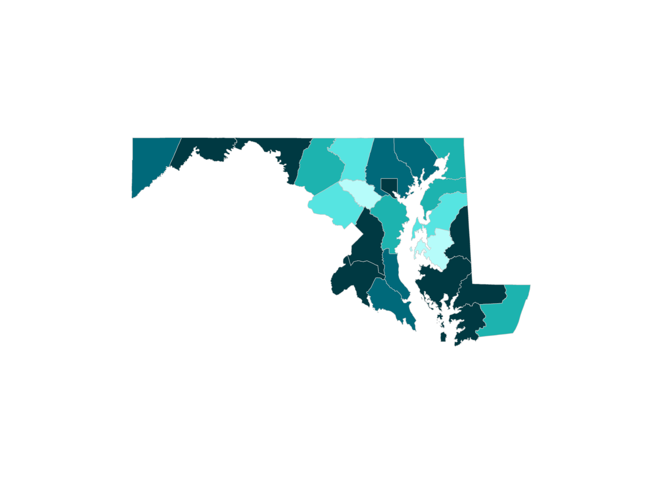
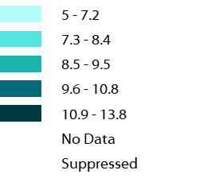
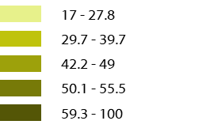
HRSN in <<STATE>>
DELETE PRIOR TO SHARING
This slide is intended to be populated using HRSN data from your area in order to contextualize the issue for your partners. While this data can be pulled from any reliable source, several resources are provided here to get you started, as shown in the MD example. The overall social vulnerability index, available through CDC’s Social Vulnerability Index (SVI) may also be useful to include here. When utilizing these resources, users can download maps directly from the site to include in discussion materials.
Using CDC’s U.S. Diabetes Surveillance System SDOH module, we can see areas in [state/county] that are experiencing high rates of HRSN and diabetes. With this information we can identify areas of overlap and potential for action.
Diagnosed Diabetes, Maryland, 2018
Free or Reduced Lunch Enrollment, Maryland, 2018
How can we use this information to form partnerships, set goals, and initiate programs?
Notes:
Using CDC’s US Diabetes Surveillance System, we can see the areas in our state/county that are experiencing high levels of HRSN and diabetes. Here we see [INSERT AREA SPECIFIC INFORMATION]. Because we know these factors influence health in our community, we want to pursue safe, cost-effective, evidence-based strategies for preventing diabetes and addressing HRSN.
Does anyone have any initial thoughts on how we can use this information to inform our next steps or potential partnerships? [PAUSE FOR DISCUSSION]

Slide 10
Prediabetes: Local Need and Landscape
DELETE PRIOR TO SHARING
This slide is intended to be populated using data from your area in order to contextualize the issue for your partners and resource links have been provided on the slide. If users do not have this information, these sections can be removed.
A person with prediabetes is at higher risk for developing type 2 diabetes and other serious health problems
Prediabetes is diagnosed when an individual’s blood sugar level is higher than normal but not at the level of diabetes
88 million people 18 years of age and older or 34.5% of the adult population have prediabetes. Additionally, 24.2 million people 65 years of age and older have prediabetes.
*insert other data points that relate to vision or are locally relevant*
In *Your State or Region*, *Number of people or percentage of population* have prediabetes.
34.5%
Of the adult population have prediabetes (Source: Centers for Disease Control and Prevention)
Source information: CDC Diabetes Data and Statistics
Notes:
One area we can begin by addressing is identifying individuals with prediabetes. Currently, about 35 percent of the national adult population has prediabetes, with many not knowing they have it, and in our area, that number is [INSERT].
By identifying individuals with prediabetes, particularly those with HRSN, we can begin to lower the prevalence and improve the health of population by preventing type 2 diabetes. One evidence-based methods we have for doing that is the National Diabetes Prevention Program lifestyle change program or National DPP. Improving coverage and access to the National Diabetes Prevention Program prevents type 2 diabetes. [TRANSITION TO NEXT SLIDE]

Slide 11
About the National DPP
To address the growing problems of prediabetes and type 2 diabetes, CDC established the National Diabetes Prevention Program (National DPP), a public-private initiative that provides the framework for type 2 diabetes prevention efforts.
Research shows that people with prediabetes who take part in this structured lifestyle change program can cut their risk of developing type 2 diabetes by 58% (71% for people over 60 years old).
Year-long program delivered in person, online, or through a combination approach
16 weekly sessions during the first 6 months and at least 6 monthly sessions during the second 6 months
Taught by trained Lifestyle Coaches and includes group support
Curriculum developed and approved by CDC (available in multiple languages here)
1000s of CDC-recognized organizations across the 50 states and D.C
Source information: CDC National Diabetes Prevention Program
Notes:
The National DPP lifestyle change program, is a year-long healthy eating and healthy lifestyle program that can be delivered in person, online, or through a combination approach. There are 16 weekly sessions in the first 6 months, followed by 6 monthly in the second half. The program is taught by trained Lifestyle Coaches with a curriculum that has been developed by the CDC. There are currently 1000s of organizations across the nation offering this program, which has been shown to reduce the risk of developing type 2 diabetes by 58 percent, and even higher for individuals over 60. [TRANSITION TO NEXT SLIDE]

Slide 12
The National DPP and HRSN
DELETE PRIOR TO SHARING
This slide is intended to represent areas that may be impacted by participation in the National DPP lifestyle change program – bubbles on the slide can be added or removed to reflect the priorities of your/your partner’s organization.
Prevent the development of type 2 diabetes in adults with prediabetes
In addition to preventing the development of type 2 diabetes, the National DPP is uniquely positioned to consider the implications of SDOH and address associated HRSN among program participants.
Examples of how states are addressing HRSN through the National DPP are provided on slide <<insert slide number>>.
Capacity to reach populations of focus
Reduced costs and healthier populations
Reduced risk of heart disease, increased weight loss, and reduction in sleep apnea
Link to other programs & services that promote health equity
National DPP Lifestyle Change Program
Focus on decision making, problem solving, & priority setting skills
Referral point to other health, behavioral, or social services
Dignity & autonomy to make healthy behavior changes
Forum to discuss the complexities of the health care system
Social support & solidarity from Lifestyle Coaches and peers
More info available on the National DPP Coverage Toolkit Addressing HRSN Through the National DPP Lifestyle Change Program page
Notes:
Because the National DPP is a year-long program, it provides multiple touchpoints to connect with participants, which can help in identifying and addressing HRSN. This may include providing : increased capacity to reach populations of focus and provide linkages and referrals to other programs to improve health equity, as well as a forum to discuss the health care system, obtain social support, build individual dignity and autonomy, and improve decision making skills. The National DPP has also been shown to improve other health conditions such as heart disease and sleep apnea. All of this information and more about the evidence behind the National DPP is available on the National DPP Coverage Toolkit, a website created by NACDD to help educate partners on the National DPP. The link is provided at the bottom of this slide. [TRANSITION TO NEXT SLIDE]

Slide 13
Addressing HRSN through the National DPP: State Examples
HRSN are most effectively addressed through cross-collaboration between health care providers, payers, government agencies, community-based organizations, and more.
Maryland
Mississippi
Alaska
Developed an eligibility algorithm
Working with providers to adapt initiatives to a patient-centered point of view
Developing referrals to community-based organizations that address HRSN
Expanded the Supplemental Nutrition Assistance Program (SNAP) program benefits
Deliver food to eligible, low-income individuals participating in the National DPP lifestyle program
Offering the National DPP through three delivery modalities
Offering online and distance learning to all eligible Alaskans free of cost
Providing 1:1 consultations with Lifestyle Coaches
Source information: National DPP Coverage Toolkit Addressing HRSN Through the National DPP Lifestyle Change Program page
Notes:
While the National DPP provides opportunities addressing participant HRSN, the effectiveness of these efforts are amplified when they are accomplished through cross-sector collaboration. According to the Collective Impact Forum (https://collectiveimpactforum.org/what-is-collective-impact/) cross-sector collaboration is the most effective method for achieving a collective impact to make health and social change. Cross-sector collaboration involves agencies and organizations from different industries or focus areas working together to achieve a shared goal. Partnerships may include State Health Departments, State Medicaid Agencies, MCOs, other payers, organizations delivering the National DPP lifestyle change program and other community-based organizations providing resources to address other HRSN, and any other community organizations that can improve the health and address the needs of the community.
The collaborations are centered around a common goal, working together to ensure that we are taking steps to meet and measure that goal, and continual communication among organizations.
On this slide are some examples of how states are collaborating with partners to address HRSN through the National DPP.
In Maryland, Maryland Department of Health, local MCOs, and organizations providing the National DPP which are referred to as CDC-recognized organizations, developed an eligibility algorithm and are working with health care providers to adapt initiatives to a patient-centered point of view to help identify and refer individuals into the National DPP and other community-based organizations that address HRSN.
In Mississippi, the State Health Department collaborated with the Dept. of Agriculture to expand SNAP benefits for low-income participants facing food insecurity.
Finally, in Alaska, they are working to offer the National DPP through multiple modalities to meet the unique geographic needs of their population, some of which are eligible for classes at no cost or receive individual 1:1 consultation with Lifestyle Coaches. [TRANSITION TO NEXT SLIDE]

Slide 14
Federal Health Equity Initiatives
The federal government is increasingly interested in promoting policies that address HRSN and improve health equity.
Examples of some of these initiatives are provided here.
Affordable Connectivity Program
National Strategy on Hunger, Nutrition, and Health
The Affordable Connectivity Program (ACP) provides eligible households $30/month off internet bills and a one-time discount of up to $100 to purchase a laptop, desktop computer, or tablet.
The National Strategy on Hunger, Nutrition, and Health is expanding access to “food is medicine” interventions, which may include medically tailored meals and food vouchers.
Source information: National DPP Coverage Toolkit Leveraging State and National Health Equity Initiatives page
Notes:
In addition to ways that we can address HRSN at the state and community level, there are also federal initiatives dedicated to addressing HRSN. For example, the Affordable Connectivity Program provides a pathway for eligible household to receive discounts on internet bills, laptops, desktops, and other devices. Additionally, the National Strategy on Hunger, Nutrition, and Health, is expanding access to ‘food is medicine’ interventions, including medically tailored meals and food vouchers for eligible participants.
It is important to us that we understand all available methods, strategies, and resources to address HRSN and improve health equity. [TRANSITION TO NEXT SLIDE]

Slide 15
Program Supports
DELETE PRIOR TO SHARING
Medicaid Implications Regarding Program Supports
There are state and federal regulations regarding how Medicaid beneficiary incentives and program supports can be provided, therefore partners should coordinate with their state’s Medicaid agency when developing a program support system.
Food Vouchers
Gift Cards
Partners can consider using program supports to enhance enrollment and retention and address participant HRSN. Studies have found that participants receiving program supports had significantly higher retention than control groups without program supports.
Which program supports do you envision could meet HRSN in our community?
Gym Vouchers
Examples of Program Supports
Transport Vouchers
Athletic Gear
Pedo-meters or scales
Source information: National DPP Coverage Toolkit The Role of Medicaid in Addressing HRSN and Retention pages
Notes:
One method that has proven effective for addressing HRSN and improving retention in the National DPP lifestyle change program is the provision of program supports to program participants. Some examples of program supports include food, transportation, or gym vouchers, athletic gear or pedometers and scales, or gift cards to grocery stores or food programs. A benefit of program supports is that they can address unique needs of each individual. Previous evaluations in Minnesota, Montana, and New York have found that participants who receive program supports had significantly higher attendance than those who did not. While program supports do not address all participant needs, they provide a method by which we can work together to improve health and social conditions in our community. We previously discussed some of the significant HRSN in our community.
Any thoughts on which program supports do you envision could meet HRSN in our community? [TRANSITION TO NEXT SLIDE]

Slide 16
Addressing HRSN in <<STATE/AREA>>
DELETE PRIOR TO SHARING
This slide is intended to illustrate to partners how the National DPP can be used as a pathway to address HRSNs and improve health equity. Several examples of how this is being done are provided, with space left to include your own examples of how you may address this with your teams.
[INSERT STATE/AREA/ORGANIZATION]
[INSERT EXAMPLES OF HOW YOUR STATE MAY ADDRESS HRSN THROUGH THE NATIONAL DPP, INCLUDING POPULATIONS OF FOCUS AND POTENTIAL VALUE PROPOSITION – SEE PREVIOUS SLIDE FOR EXAMPLES]
Notes:
Here is an example of how we [are/anticipate] we could address HRSN in our area. [INSERT STATE SPECIFIC EXAMPLE]

Slide 17
Potential Roles for Partners in <<State>>
DELETE PRIOR TO SHARING
This table is designed to provide an overview of the ways that providers, payers, government agencies, and CDC-recognized organizations can work together to advance equity and address SDOH. This version is modifiable to fit the needs of your organization. You may change the organization titles, the areas of focus and put check marks in relevant boxes. An example of how the table may be completed is available on the Coverage Toolkit (https://coveragetoolkit.org/health-equity-and-the-national-dpp/connecting-to-state-and-national-initiatives/)
Focus
Health care Providers
Payers
Government Agencies
CDC-Recognized Orgs*
Coordinating with partners across sectors can improve efficiencies in addressing HRSN. Examples of partner roles are provided here.
Organizational commitment to health equity
Building and maintaining a culturally diverse workforce
Delivering services in a culturally responsive way
Screening for HRSN
Collecting data on health disparities and HRSN
Analyzing data and information to inform program design
Delivering interventions that address HRSN and health disparities
Support and infrastructure for interventions that address HRSN
Regulating and enforcing rules requiring health equity focus
Implementing payment arrangements to address health equity and HRSN
Key
Foundational
Collaborative
Sustaining
*The National DPP is offered through CDC-recognized organizations which have received full, pending, or preliminary recognition from the CDC’s Diabetes Prevention Recognition Program
Notes:
On this slide, we wanted to illustrate how cross-sector collaboration can align goals and workflows to improve health equity. For example, if we look at box one, “Organizational commitment to health equity”, we can determine which organization or organizations may be responsible for helping to achieve this focus area. For this box, I think it is fair to say that each organization indicated is dedicated to this goal. For other focus areas, such as the fourth row, “Screening for HRSN”, we can work together to discuss which organization can take responsibility for this and how we can disseminate the information effectively. This can help to serve as a groundwork for building our partnership. [TRANSITION TO NEXT SLIDE]

Slide 18
Medicaid and HRSN
DELETE PRIOR TO SHARING
Users should tailor the Medicaid enrollment statistics in this table to reflect their populations. Users can determine if they want this information to reflect Medicaid fee for service or Medicaid managed care. In addition to the categories provided, users can also include demographic data for their Medicaid beneficiaries when available.
[STATE] Medicaid Enrollees by Enrollment Group
Dual Eligible Individuals | Individuals with Disabilities | Adults | Newly Eligible Adults | Total
Medicaid beneficiaries:
are more likely to have lower health status than those on private insurance
are disproportionately women & people from racial/ethnic minority groups
often experience multiple HRSNs
[STATE] Medicaid Managed Care Enrollees by Enrollment Group
Dual Eligible Individuals | Individuals with Disabilities | Adults | Newly Eligible Adults | Total
Source: KFF Medicaid Enrollees by Enrollment Group
Source information: National DPP Coverage Toolkit The Role of Medicaid in Addressing HRSNs page
Notes:
When we begin identifying priority populations that are likely to have the most benefit from participation in the National DPP lifestyle change program, we often want to begin by looking at our Medicaid population. As indicated here, Medicaid beneficiaries are more likely to have a lower health status than those on private insurance, are disproportionately women and racial/ethnic minority groups, and often have multiple HRSN. In [STATE], our Medicaid population is broken up as indicated here on the right side of the screen. [INSERT DETAILS] [TRANSITION TO NEXT SLIDE]

Slide 19
Pathways to Medicaid Coverage
DELETE PRIOR TO SHARING
This slide is intended for users who are making the case for coverage of the National DPP and may not be necessary for users with existing coverage.
Medicaid coverage of the National DPP lifestyle change program can help in addressing HRSN among Medicaid beneficiaries.
Pathways to Coverage
Partners can consider several pathways of using Medicaid policy to advance health equity, including:
1115 waivers
MCO contracting
value-added services
value-based payments
blended funding
data and quality improvement strategies
Partners can also consider additional methods, like program supports, to address health equity through Medicaid.
Source information: National DPP Coverage Toolkit The Role of Medicaid in Addressing HRSNs page
Notes:
As we mentioned in the slide above, the National DPP lifestyle change program provides a format with multiple touchpoints to not only reduce the risk of developing type 2 diabetes but addressing HRSN as well. There are various methods that can be used as pathways to coverage of the program, including 1115 waivers, MCO contracting, value added services and payments, blended funding, and data quality improvement strategies. Covering and offering the National DPP lifestyle change program can work in tandem with larger state or national goals, initiatives, or objectives related to addressing health equity, such as reducing the rates of chronic disease in populations of focus, addressing disparities in accessing preventive services, or working to increase access to healthy foods across populations. [TRANSITION TO NEXT SLIDE]

Slide 20
Umbrella Hub Arrangements
An umbrella hub arrangement (UHA) is a business agreement between organizations, where a lead organization, the umbrella hub organization (UHO), submits payer claims and provides technical assistance to other community-based organizations (CBO) to support expansion of the National DPP. In the UHA, CBOs are known as subsidiary organizations.
 | Reasons to Become a UHO |  | Reasons for Subsidiary Organizations to Participate in the UHA |  | Reasons for a Payer to Contract with a UHA
 | Serve as a critical partner to support CBOs Elevate the organization’s profile and involvement in the effort to prevent type 2 diabetes Advance health equity by increasing access to the National DPP |  | Join other mission-aligned organizations Share CDC recognition status and operate as a single MDPP supplier with the UHA Receive reporting, claims, and administrative support to allow subsidiaries to focus on delivering the National DPP Pursue sustainable reimbursement |  | Gain access to a network of CDC-recognized organizations through a single contract with the UHO Experience a smoother and more efficient billing process
Source information: National DPP Coverage Toolkit Umbrella Hub Arrangement Overview Page
Notes:
UHAs are another mechanism that can work along with plans to expand coverage that support increase access to the National DPP through creation of a community network.
An umbrella hub arrangement (UHA) is a business agreement between organizations, where a lead organization, the umbrella hub organization (UHO), submits payer claims and provides technical assistance to other community-based organizations (CBO) to support expansion of the National DPP. In the UHA, CBOs are known as subsidiary organizations. UHAs can also involve additional partners like state health departments, billing or referral platforms, managed care organizations, and more. More information on establishing UHAs is available on the National DPP Coverage Toolkit UHA pages. While there are a variety of reasons why each partner may want to participate in the UHA, some of which are listed here, today we are going to focus on those that pertain to our health equity goals. [TRANSITION TO NEXT SLIDE]

Slide 21
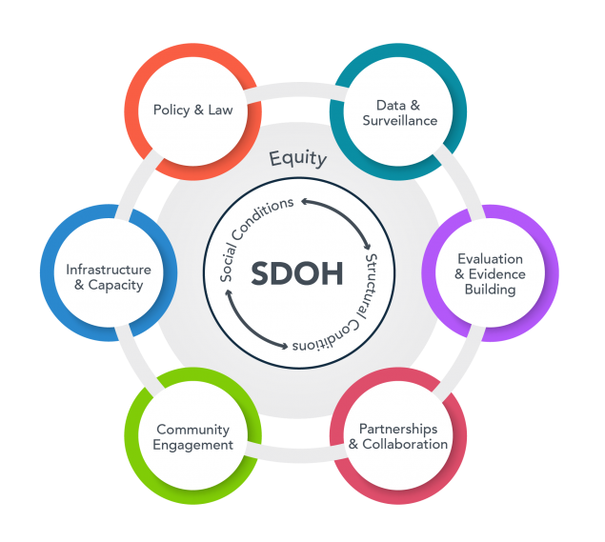
SDOH and the UHA
CDC’s SDOH framework outlines 6 areas for addressing SDOH to improve health equity. Through the UHA, partners can:
Make the case for coverage of the National DPP in states where it is not currently a covered benefit
Aggregate and submit data to the DPRP portal on behalf of their subsidiary organizations and assist in collecting additional National DPP or population data
Provide support to CBOs to access sustainable reimbursement & increase the capacity for CBOs to identify and address HRSN
Support partners in building an evaluation plan and disseminating evaluation results
Build hyper-localized systems for understanding community needs, addressing HRSN and removing barriers to National DPP participation.
Provide participants with high quality, coordinated care to address HRSN through cross-sector partnerships
Notes:
At its core, the UHA addresses health equity by connecting CBOs to resources to overcome barriers and focus on meeting the needs of their communities. Using CDC’s SDOH framework we can see how the UHA affects SDOH and improve health equity in the following six areas.
Infrastructure and capacity: CBOs are a vital part of the public health system and often have important connections to the priority populations they serve. In the UHA, the UHO provides critical administrative and technical support to access sustainable reimbursement pathways to participating CBOs, which increases the capacity for subsidiary organizations to identify and address the needs of their communities.
Community engagement: Disparities in diabetes outcomes exist in populations with different SDOH and CBOs with trusted relationships in communities can reach people healthcare systems or payers may have difficulty reaching. By forming a network of CBOs with unique strengths and community connections, the UHA can build hyper-localized systems for addressing HRSN and removing barriers to National DPP.
Data and surveillance: UHOs have the option to be responsible for data aggregation and submission to the CDC data portal on behalf of their subsidiary organizations which allows for smaller CBOs to retain CDC-recognition in the event they do not meet cohort minimums individually. UHOs can assist in collecting National DPP landscape, participant, and SDOH data which can help CDC-recognized organizations build their UHA, improve program retention efforts, and address HRSN.
Partnerships and collaborations: UHAs consist of many partnerships and collaborations. By understanding community needs and aligning priorities across participating organizations, cross sector partnerships can help to provide participants with high quality, coordinated care to address HRSN.
Evaluation and evidence building: Evaluating participant data can help UHA partners understand the needs of the community and identify processes to address those needs. The UHO can support subsidiary organizations in building out an evaluation plan, communicating and coordinating evaluation efforts with various partners, and disseminating evaluation results to interested parties. UHOs can also take responsibility for ensuring that contracts with subsidiary organizations and payers include provision of data and participation in evaluation processes.
Policy and law: UHAs can work with state partners to make the case for coverage of the National DPP in states where it is not currently a covered benefit, build relationships with Medicaid authorities to influence the contractual requirements of MCOs to pay for HSRN, and potentially assist state partners in enacting policies and processes which improve health equity. As they build towards sustainability UHAs can advocate for value-based payment mechanisms which recognize and rewards the UHA’s ability to support improved health outcomes for priority populations. [TRANSITION TO NEXT SLIDE]

Slide 22
Addressing HRSN through the National DPP: UHA Examples
HRSN are most effectively addressed through cross-collaboration between health care providers, payers, government agencies, community-based organizations, and more.
AAPCHO
HPCA
NKFM
The Association of Asian Pacific Community Health Organizations (AAPCHO) UHO:
Developed National DPP curricula that incorporated health beliefs and cultural approaches specific to their communities
The Hawai'i Primary Care Association (HPCA) UHO:
Holds regular meetings with their subsidiary organizations to present and train on topics relevant to their participant population
The National Kidney Foundation of Michigan (NKFM) UHO:
Provided InstantPots with culturally appropriate recipes as program supports to National DPP program participants who meet certain program milestones
Notes:
Umbrella hub arrangements can offer a centralized format for organizing cross-sector collaboration. According to the Collective Impact Forum (https://collectiveimpactforum.org/what-is-collective-impact/) cross-sector collaboration is the most effective method for achieving a collective impact to make health and social change. When we refer to these cross-sector partnerships, that may include the UHA and subsidiary organizations, the State Health Departments, State Medicaid Agencies, MCOs, other payers, other community-based organizations providing resources to address other HRSN, and any other community organizations that can improve the health and address the needs of the community.
The collaborations are centered around a common goal, working together to ensure that we are taking steps to meet and measure that goal, and continual communication among organizations.
On this slide are some examples of how UHAs are collaborating with partners to address HRSN through the National DPP.
At the Association of Asian Pacific Community Health Organizations (AAPCHO) partners have developed curricula that incorporated health beliefs and cultural approaches which were specific to the Asian American, Native Hawaiian, and Pacific Islander communities and provide the program in languages spoken in their communities.
In Hawaii, the Hawaii Primary Care Association holds regular meetings with their subsidiary organizations to learn and reflect on relevant topics, including health equity and addressing the needs of their populations.
Finally, the National Kidney Foundation of Michigan is providing program supports of Instant Pots with culturally relevant recipes to their participants who meet certain milestone. This helps to address food insecurity and provides resources for those who may have limited access to food preparation appliances. [TRANSITION TO NEXT SLIDE]

Slide 23
Addressing HRSN in <<STATE/UHA>>
DELETE PRIOR TO SHARING
This slide is intended to illustrate to partners how the National DPP can be used as a pathway to address HRSNs and improve health equity. Several examples of how this is being done are provided, with space left to include your own examples of how you may address this with your teams.
[INSERT STATE/UHA]
[INSERT EXAMPLES OF HOW YOUR STATE OR UHA MAY ADDRESS HRSN THROUGH THE NATIONAL DPP, INCLUDING POPULATIONS OF FOCUS AND POTENTIAL VALUE PROPOSITION – SEE PREVIOUS SLIDE FOR EXAMPLES]
Notes:
Here is an example of how we [are/anticipate] we could address HRSN in our UHA. [INSERT STATE SPECIFIC EXAMPLE]

Slide 24
Additional Discussion Questions
How has this content been resonating with you thus far?
What are the health equity priorities for your organization?
How can the partnership with the National DPP help to accomplish some of these goals?

Slide 25
Engagement Tips
DELETE SLIDE BEFORE PRESENTING
Make discussion points relevant to your local environment
Adjust the presentation length to the time you have with your audience
Leave time for discussion
Intersperse discussion throughout the presentation
Please give NACDD feedback on this deck at <<INSERT>>

Slide 26
Additional Resources
DELETE SLIDE BEFORE PRESENTING
DELETE PRIOR TO SHARING
This slide is intended to provide users additional resources for implementing processes to understand, screen, and refer patients to HRSN resources. It is not intended to remain as a portion of the presentation.
Tips for identifying SDOH and addressing HRSNs
The Minnesota Best Practices Guide for Lifestyle Coaches and Program Coordinators highlights several ways Lifestyle Coaches can address HRSN to support participant success in the National DPP lifestyle change program.
The National Clinical Care Commission released a report to congress that provides a framework for diabetes prevention and control, including the complexity of population health outcomes and health equity in relation to diabetes.
Incorporating SDOH screening tools
The Protocol for Responding to and Assessing Patients’ Assets, Risks, and Experiences (PRAPARE) is designed to equip partners to better understand and act on individuals’ HRSN. PRAPARE covers personal characteristics, family/home life, money/resources, and social/emotional health and has a corresponding Implementation and Action Toolkit that compiles resources, best practices, and lessons learned on how to implement a HRSN data collection initiative.
The Accountable Health Communities Health Related Social Needs Screening Tool, designed by the CMS Center for Medicare and Medicaid Innovation (CMMI) to evaluate if screening for HRSN influences total health care costs and health outcomes, includes ten items categorized into five domains: housing stability, food security, transportation, utility needs, and interpersonal safety.
The HealthBegins Upstream Risks Screening Tool was developed for health care providers to incorporate SDOH data to inform patient care and health outcomes and includes education, employment, social connection, physical activity, immigration, and more.
Connecting SDOH, COVID-19, and type 2 diabetes
In August 2021, NACDD released a white paper on the connection between COVID-19 and type 2 diabetes underscoring the need for chronic disease prevention and management.

